Slide 1
Software Quality Assurance
By Cara Murphy

Slide 2

Quality
The standard of something as measured against other things of a similar kind; the degree of excellence of something.
“I can assure you this presentation is quality”
- Jonathan Burgess

Slide 3
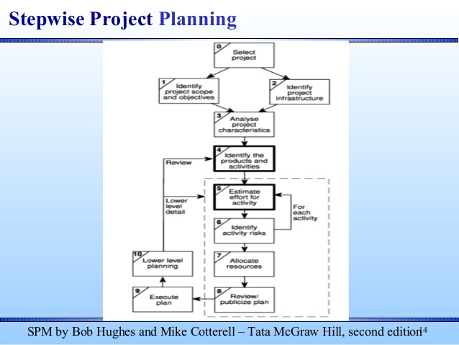

Slide 4

Standards for Quality Assurance
The fundamental objective of the ISO/IEC 9126 standard is to address some of the well known human biases that can adversely affect the delivery and perception of a software development project. These biases include changing priorities after the start of a project or not having any clear definitions of "success". By clarifying, then agreeing on the project priorities and subsequently converting abstract priorities (compliance) to measurable values (output data can be validated against schema X with zero intervention), ISO/IEC 9126 tries to develop a common understanding of the project's objectives and goals.

Slide 5
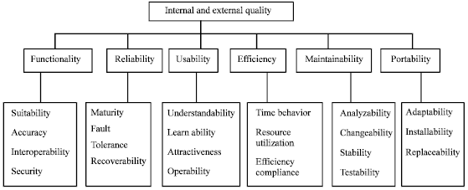
Quality Model

Slide 6
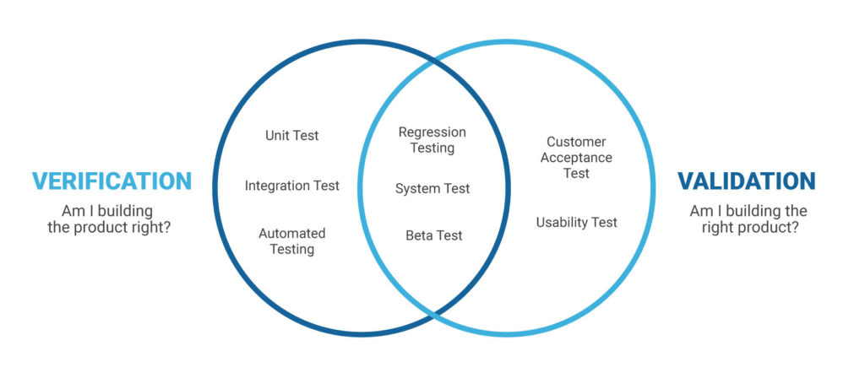
Validation and Verification

Slide 7
Case Study:
Brightmouth College is a higher education institution which used to be managed by a local government authority but has now become autonomous. Its payroll is still administered by the local authority and pay slips and other output are produced in the local authority’s computer centre. The authority now charges the college for this service. The college management are of the opinion that it would be cheaper to obtain an “off-the-shelf” payroll package and do the payroll processing themselves. Brightmouth College have recently hired a new Information Systems Development Officer, who has been asked to manage the independent payroll processing project.

Slide 8
Reference
Hughes and Cotterell, Software Project Management, 4th / 5th edition, Chapter 12 (4th ed.) or Chapter 13 (5th ed.).
Sommerville, Software Engineering, 9th edition, Chapter 24
https://en.wikipedia.org/wiki/Software_quality
https://en.wikipedia.org/wiki/ISO_9000

